Slide 1
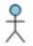

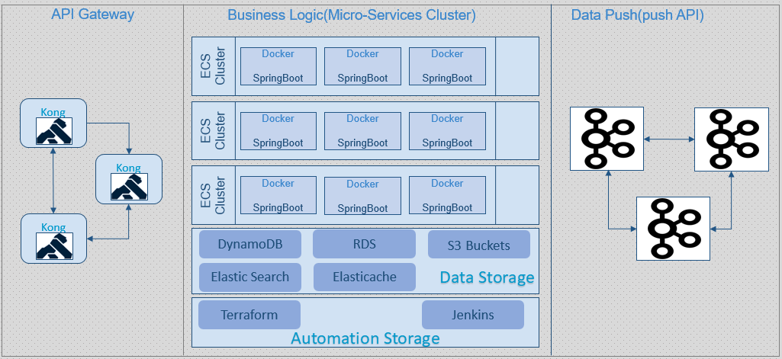
Client Application
[server side]
API Platform
Business Systems
Customer Community
Internet
Internet
VPN
Cloud Platform
Client Application

Slide 2


API Gateway
Business Logic(Micro-Services Cluster)
Data Push(push API)
ECS
Cluster
Docker
SpringBoot
Docker
SpringBoot
Docker
SpringBoot
Kong
ECS
Cluster
Docker
SpringBoot
Docker
SpringBoot
Docker
SpringBoot
Kong
ECS
Cluster
Docker
SpringBoot
Docker
SpringBoot
Docker
SpringBoot
Kong
DynamoDB
RDS
S3 Buckets
Elastic Search
Elasticache
Data Storage
Terraform
Jenkins
Automation Layer

Slide 4




Client applications

Slide 5
Automation Layer
Devops
Jenkins
Template service
Self service channel

Slide 6
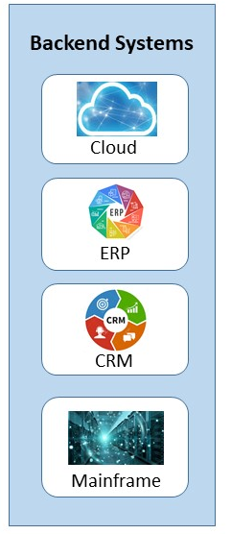
API Layer
Automation Layer
Business Logic(Micro-Services)
kubernetes
Cluster
Docker container
Docker
container
Docker
container
Self Service
Orchestration
Business Process Flow
Docker
Template Service
DynamoDB
Data Storage
RDS
S3 Buckets
Elastic Search
Elasticache
Devops

Slide 7
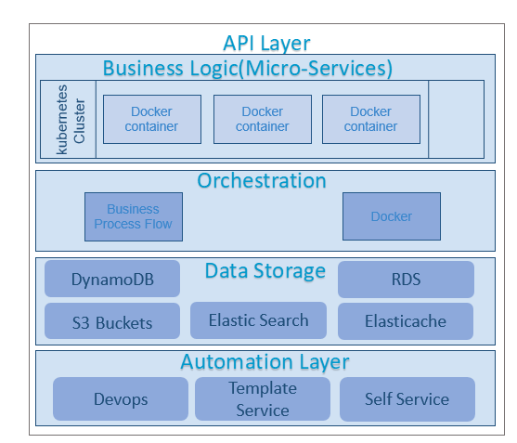

Slide 8
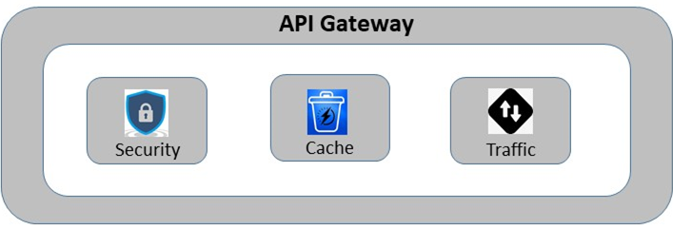

Slide 9
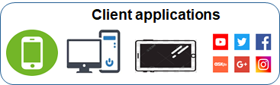
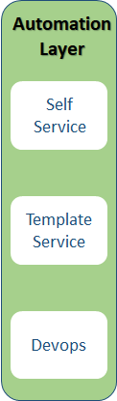
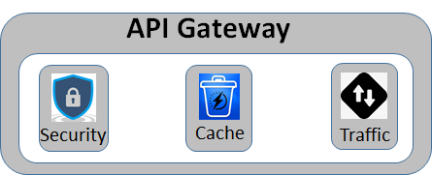
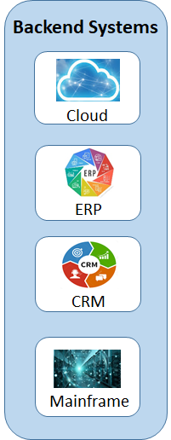
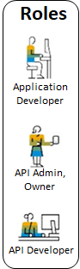
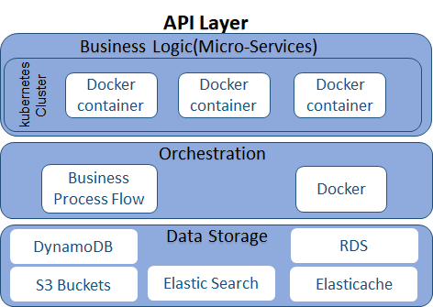
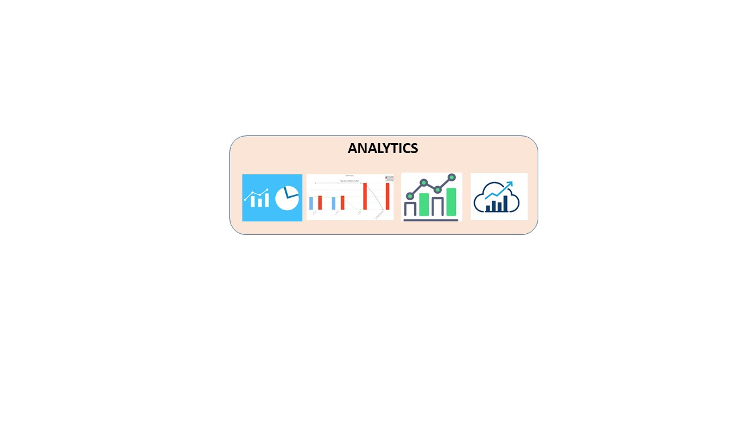

Slide 10




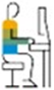
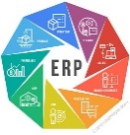
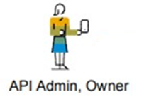
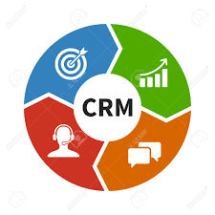
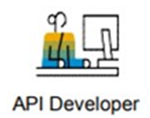


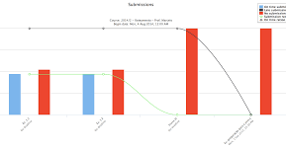


Client applications
API Gateway
Backend
Systems
Automation Layer
Roles
Self Service
Security
Cache
Traffic
Cloud
Application Developer
API Layer
Business Logic(Micro-Services)
Template Service
ERP
kubernetes
Cluster
Docker container
Docker
container
Docker
container
API Admin, Owner
Orchestration
CRM
Devops
Business Process Flow
Docker
API Developer
DynamoDB
Data Storage
RDS
Mainframe
S3 Buckets
Elastic Search
Elasticache
ANALYTICS

Slide 11
ANALYTICS

Slide 12
